Slide 1

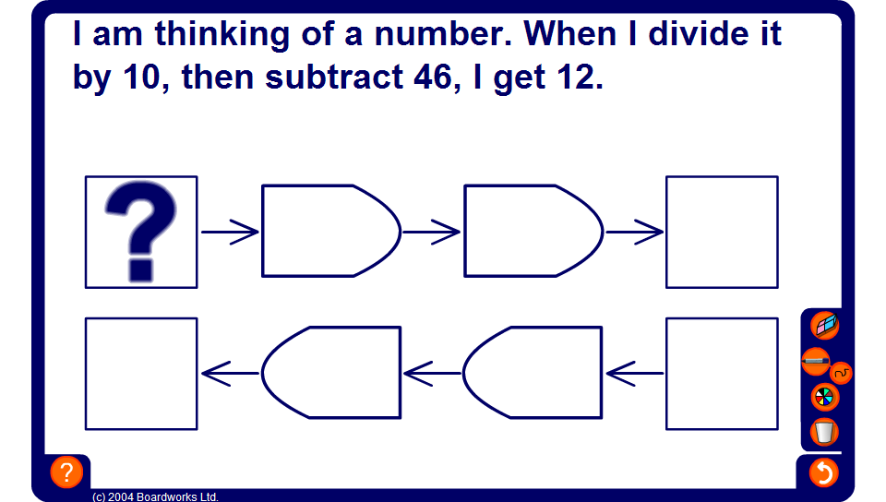


What number am I thinking of…?
Notes:
Start by asking pupils to solve the problem without using diagrams. If someone finds the answer ask them how they worked it out.
They may have used trial and error, trying different numbers until they found one that worked. Stress that although this will give you the correct answer eventually this method can take a long time.
Talk about what operations have been performed on the number and reveal each stage of the first diagram.
Now, explain that if we start with the answer and ‘undo’ the operations we can find the number we started with.
Pupils should know that to ‘undo’ addition we subtract and to ‘undo’ multiplication we divide. These are called inverse operations. Inverse means opposite.
Stress that we must also reverse the order.
(When you get dressed in the morning you put on your socks and then your shoes. When you ‘undo’ this when you get undressed you have to take off your shoes and then socks. The order is reversed.)
Reveal each step in the second diagram to find the mystery number.
Repeat the activity several times to ensure that pupils can complete these steps mentally.
This activity will also practise multiplication tables to 10 x 10 and the associated division facts.

